Slide 1
Enterprise Architecture and
TOGAF 9 Overview
Winton Huang
wintonjkt@gmail.com

Slide 2
Agenda
Part I Overview of Enterprise Architecture
Part II TOGAF Overview

Slide 3
Part I
Overview of Enterprise Architecture

Slide 4
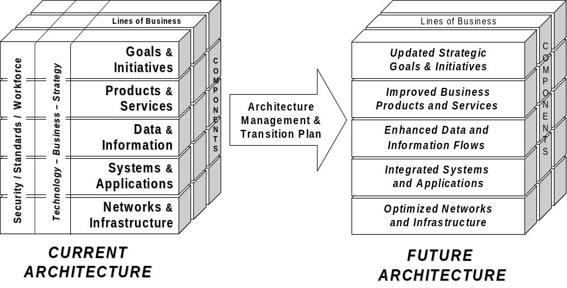
The Concept of Enterprise Architecture - Defined
Enterprise Architecture: The analysis and documentation of an enterprise in its current and future states from a strategy, business, and technology perspective. EA = S + B + T
An Introduction to Enterprise Architecture © 2005

Slide 5

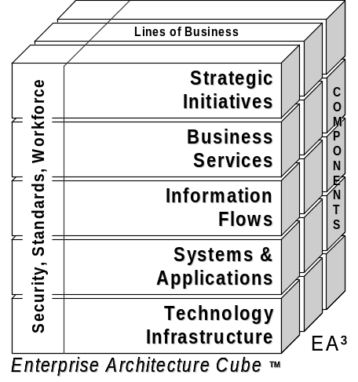

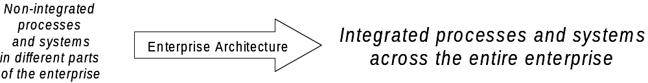
The Concept of Enterprise Architecture – Overview
Enterprise Architecture helps to integrate and manage IT resources from a strategy and business-driven viewpoint
Strategic
Strategic
Initiative 1
Strategy
Initiative 1
Strategy
Strategic
Strategic
Initiative 2
IT
Initiative 2
IT
Systems
Systems
Video
Video
Network
Network
Process 1
Strategic
Process 1
Strategic
Business
Initiative 1
Business
Initiative 1
Process 2
Process 2
Process 1
Process 1
Process 3
Process 3
Data
Data
Network
Network
Data
Data
EA = S+B+T
Dictionary
Dictionary
Object
Object
Business & Technology Alignment
Information
Business & Technology Alignment
Information
Data
Data
Data
Reuse
Data
Process 2
Reuse
Process 2
Flows
Flows
Dictionary
Dictionary
Applications
Web
Applications
Web
Services
Services
Systems
Systems
Web
Strategic
Web
Strategic
Systems
Systems
Services
Initiative 2
Services
Initiative 2
Applications
Voice
Applications
Voice
Network
Network
Object
Data
Object
Data
Reuse
Reuse
Data
Flows
Data
Flows
Network
Network
Voice
Networks
Voice
Network
Video
Network
Video
Network
Network

Slide 6



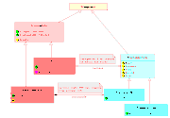
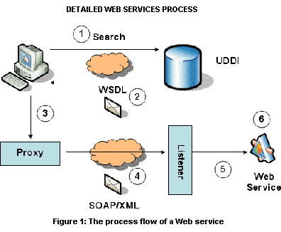
Enterprise Architecture Domain
Define the Enterprise Strategy, goals and
Objectives: What to do, and how to do it?
Strategy
Business Processes: support the strategy,
Operational organization
Business
Métier
The Applications support the Business,
implement the business functions in the IT systems
Applications & Systems
Information & Data
The Information is key for the organization:
It is the fuel that drives the architecture
Infrastructure that supports the IS:
Technical components: servers, networks, etc.
Technology: platforms, etc.
Network & Infrastructure

Slide 7
The Concept of Enterprise Architecture - Drivers
  Executive input on strategic direction and priority
  Business Manager input on process changes
  Technology Manager input on supporting IT changes
New Direction & Goals
(Leadership Team)
Operating
Scenarios
Capabilities
of the
Current
Enterprise
Strategic
Capabilities
of the
Future
Enterprise
New Business Priorities
(Management Team)
Tactical
Program
Plans
Emerging Technologies
(IT Support Team)

Slide 8
Enterprise Architecture
A spectrum of goals, scopes, and entry points
Cost Reduction
What do we have?
Need all of it?
Consolidate to reduce costs?
Desire for impact analysis
Standardization
Develop standards and recommended best practices (e.g. technology stacks, server platforms)
Seeking repeatability
Encourage IT evolution
Focusing on IT scope only
Broaden Scope
Meet business needs by linking IT to business
Managing architectures outside IT
Increasing focus on business architecture and business processes
Actionable EA
Develop business strategy
Value propositions, capabilities, resources?
Refine into to-be
Compare to as-is
Create transition plan
Execute
Enabling Organizations to Turn Change into a Competitive Advantage
Notes:
Multiple entry points for realizing value
All recognize the need to manage both upstream planning and downstream delivery
Some organizations will move through a progressive set of phases as they progress
…I want to avoid any confusion that, in order to make EA work, you need to do it all. In fact, far from it: it could be an excellent recipe for disaster, to include all the ingredients right at the start.
There are many aspects to EA’s value propositions – these are just four of the most common. Some emphasize how EA can help take cost out of an enterprise’s business and IT infrastructure, others focus on the creation of value. While there is some degree of increasing sophistication left to right, these things do not need to be done in sequence, or in depth before embarking on another. The vital point here is that the purpose behind an enterprise’s architecture needs to be clear: its value propositions are worthless, if the enterprise does not understand how they can indeed bring value.
Cost Reduction phase
Often a small team driven by IT involving collection of data from many people
Where is the collected data assembled and analyzed?
Implications:
Few people involved for a short time is unattractive, ongoing use of data by many people is very attractive, so encourage promotion to Dynamic EA.
Thus let people know the vision—many will see the value—yet embrace the first steps
Standardization phase
Drive cost reductions throughout organization
Similar in structure to cost reduction
Implications:
Beginning to take a longer-term view of cost reduction
Broaden Scope phase
Embraces business side
Broader scope often requires a leader or sponsor spanning business and IT
Formalizes the organizational structure for EA
Easier if both business and IT are split along business unit lines.
Implications:
EA tool must handle broader scope
Channel sells higher in business
Actionable EA phase
Formal organizational structure for EA with clearly-defined roles
Implications:
Solution tooling that connects to and leverages the EA will be highly-prized, especially if it supports governance. Applies to all phases, hottest here.

Slide 9
Value of Enterprise Architecture
Provides a clear view of how the business and technology resources will support and achieve an organization’s business goals and initiatives.
Understand the strategy, the business, the systems and the infrastructure and how they interrelate.
Moving "need to know" information to those that "know they need" upstream and down stream and in both directions.
Helps us prioritize and decide which things to do and in what order.
  “Doing the Right Things”
Governs the change and building of things.
  “Doing the Things Right”

Slide 10
Result of Implementing Enterprise Architecture
  Achieve strategic goals that depend on IT resources
  Improve business performance by maximizing IT efficiency
  Strategic priorities/business requirements drive IT solutions
  Total visibility of multiple IT networks, systems, applications, services, and databases across the entire enterprise
  Share information between lines of business
  Reduce duplicative IT resources across the enterprise
  Protect data and IT assets that rely on enterprise-wide approaches
  Maximize the effective use of limited budgets

Slide 11
Part II
TOGAF
Overview

Slide 12
Definition of TOGAF
The Open Group Architecture Framework (TOGAF) is a framework and detailed method for building, maintaining, and gaining value from an enterprise architecture for an organization.
TOGAF 9 is the latest evolution of the framework, and its accompanying Architecture Development Method (ADM)
The TOGAF specification is an open standard that has been created and is maintained by The Open Group (www.opengroup.org).

Slide 13
Types of Architectures in TOGAF
Business Architecture -- addresses the needs of users, planners, and business management,
Data/Information Architecture -- addresses the needs of database designers, database administrators, and system engineers,
Application (Systems) Architecture -- addresses the needs of system and software engineers, and
Information Technology (IT) Architecture -- addresses the needs of acquirers, operators, administrators, and managers.

Slide 14
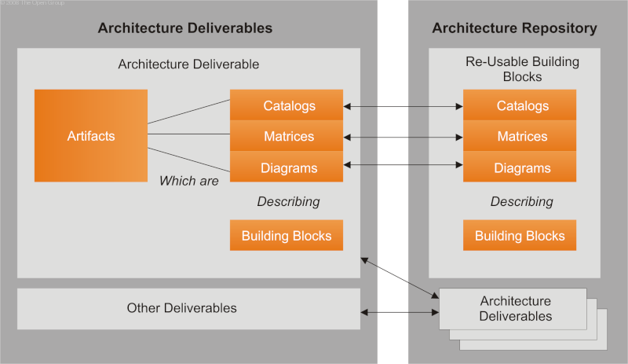
Architecture Deliverables

Slide 15
Deliverable is a work product that is contractually specified and in turn formally reviewed, agreed, and signed off by the stakeholders. Deliverables represent the output of projects and those deliverables that are in documentation form will typically be archived at completion of a project, or transitioned into an Architecture Repository as a reference model, standard, or snapshot of the Architecture Landscape at a point in time.
Artifact is a more granular architectural work product that describes an architecture from a specific viewpoint. Examples include a network diagram, a server specification, a use-case specification, a list of architectural requirements, and a business interaction matrix. Artifacts are generally classified as catalogs (lists of things), matrices (showing relationships between things), and diagrams (pictures of things). An architectural deliverable may contain many artifacts and artifacts will form the content of the Architecture Repository.
Building block represents a (potentially re-usable) component of business, IT, or architectural capability that can be combined with other building blocks to deliver architectures and solutions.

Slide 16
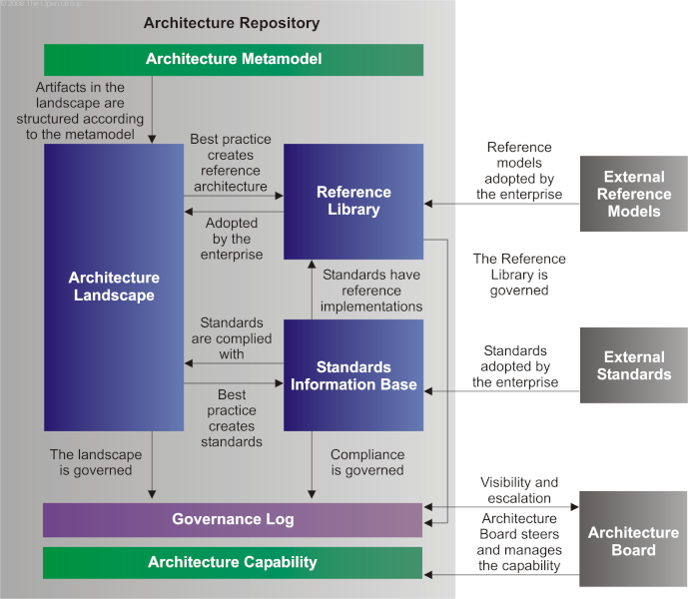
Architecture Repository

Slide 17
Architecture Repository
The Architecture Metamodel describes the organizationally tailored application of an architecture framework, including a metamodel for architecture content.
The Architecture Capability defines the parameters, structures, and processes that support governance of the Architecture Repository.
The Architecture Landscape shows an architectural view of the building blocks that are in use within the organization today (e.g., a list of the live applications). The landscape is likely to exist at multiple levels of abstraction to suit different architecture objectives.
The Standards Information Base (SIB) captures the standards with which new architectures must comply, which may include industry standards, selected products and services from suppliers, or shared services already deployed within the organization.
The Reference Library provides guidelines, templates, patterns, and other forms of reference material that can be leveraged in order to accelerate the creation of new architectures for the enterprise.
The Governance Log provides a record of governance activity across the enterprise

Slide 18
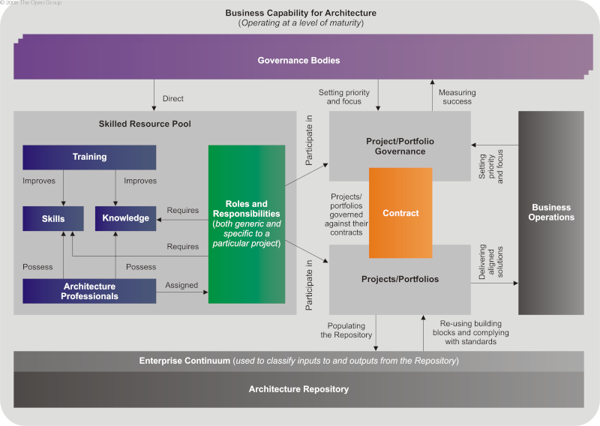
TOGAF Architecture Capability

Slide 19
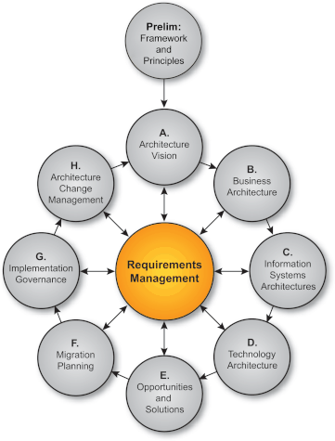
The Framework of TOGAF 9
The TOGAF framework provides the core phases of the Architecture Development Method (ADM), presented as circles surrounding requirements.
Bidirectional lines are drawn from each of the outer ADM circles to the center Requirements circle. This represents how requirements drive the creation of the architecture, and how the architecture is created to satisfy requirements.

Slide 20
Overview of TOGAF Phases
A. Define Architectural Vision
B. Business Architecture
C. Information Systems Architecture
D. Technology Architecture
E. Assess Opportunity and Solution Alternatives
Start here
Finish here

Slide 21
Architectural Vision
In Phase A of the TOGAF Architecture Development Method (ADM) you establish the scope of the architecture effort, get buy in from senior management and line management, and develop the vision of the architecture effort.
The phase starts with a Request for Architecture Work, delivered from the sponsoring organization to the architecture organization, and results in a Statement of Architecture Work.

Slide 22

Objectives
Understand and learn how to define the enterprise’s strategic context
  La raison d'entre of the enterprise, it's motivation and direction
  It’s scope and constraints
  How it is going to achieve it’s goals
Value Statement
  Guides the development and direction of the enterprise and it’s architecture
  Forms the basis and scope of all subsequent work and usage of the architecture

Slide 23
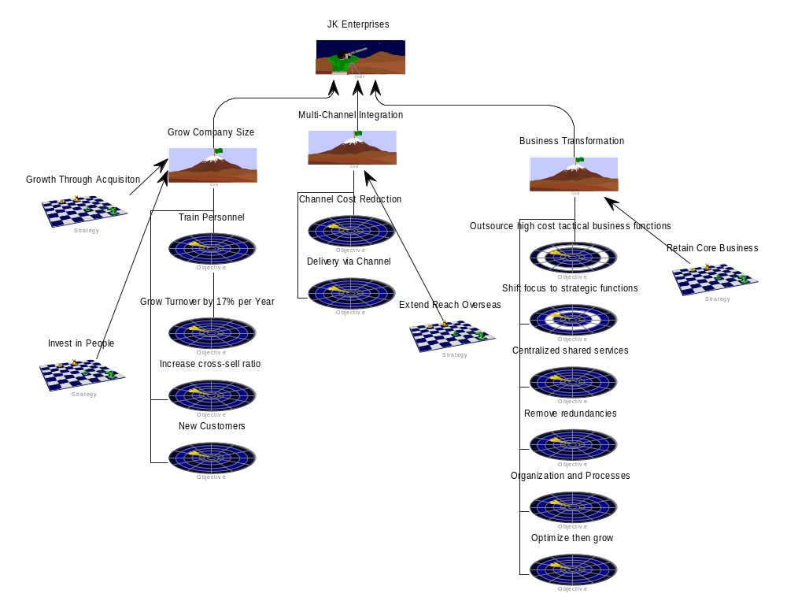
Define Architectural Vision
Enterprise Direction Diagram
  provides the statements of business motivation, business goals, strategies, and tactic.
  It shows the end we want to achieve and the means of how to get there.
Notes:
The Enterprise Direction diagram enables graphical modeling of the motivation and goals of your organization, the strategies and tactics devised to obtain those goals, and the business rules and policies that effect the strategies and tactics.
Here we are showing only Vision, Goals, Objective and Strategy.

Slide 24
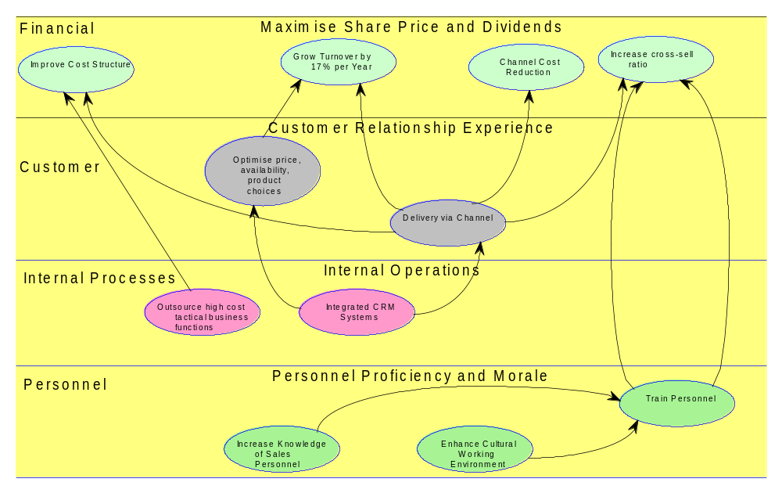
Define Architectural Vision
Strategy Map Diagram
  Visual representation of the key Business Objectives aligned with balancing perspectives.
Notes:
The Strategy Map diagram enables describes visually the organization's key Business Objectives and how they align with the four Balanced Scorecard perspectives to support corporate strategies.
Point out that this use the same Objectives from the Enterprise Direction diagram
Map out key Business Objectives against the four Balanced Scorecard perspectives
your organization's financial perspective,
what you would like your customers' perspective of your organization to be,
your organization's internal process-oriented perspective,
and your organization's human-capital perspective.

Slide 25
Define Architectural Vision
Requirements
  These define what capabilities the enterprise must support or provide in its operations.
  They are central to, define, and continuously drive the enterprise's architecture.
  Applicable to any and all phases of the lifecycle.

Slide 26
Define Architectural Vision
Requirements
These exist in many guises, ones that are explicitly defined and are clearly catered for include
  Business Goals and Objectives
  Business Constraint
  Critical Success Factors
  Customer Needs Summary
  Customer Requirement
  Issue
  Policy
  …
Generic Requirements
These are handled as a “Requirement” definition and related to the architecture through either explicitly defined or loose relationships.
Notes:
Explain that there are many forms of Requirements and these are explicitly handled as definition types, a generic form of definition is “Requirement” and that this is used to capture key needs of functionality that the enterprise must do.
An explicitly defined relationships is one that exists as in the meta-model, e.g. Requirements as a listof in an Architectural Building Block definition.
Or loose relationships via the addresses relationship.

Slide 27
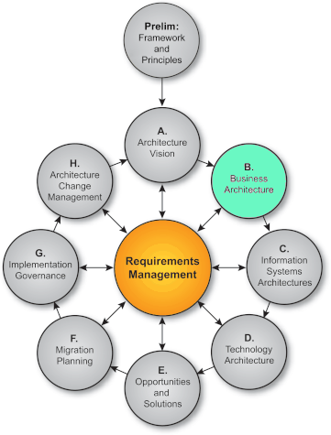
Overview of TOGAF Phases
A. Define Architectural Vision
B. Business Architecture
C. Information Systems Architecture
D. Technology Architecture
E. Assess Opportunity and Solution Alternatives
Plus: Plan, Govern and Execute Solutions
Start here

Slide 28
Definition of Business Architecture
In Phase B of the TOGAF Architecture Development Method (ADM) you establish the Business Architecture of the organization
The objectives of building the business architecture are to understand, describe, and model the current (or baseline, or 'as is') business architecture, and then develop target, or to-be business architectures. In System Architect, you may use Workspaces to enable baseline and target architectures

Slide 29
Objectives of Business
We intend to compare two businesses which:
  Do similar things In different ways with different resources
We will produce a conceptual model that is common to both businesses in terms of
  Business
  Information
  Application
  Technology Infrastructure
Value Statement
Provide a framework in order to compare similar resources

Slide 30
Topics
Capturing Key Business Concepts
Conceptual Business Architecture
  Conceptual Capability Model
  Building the Business Activity Model
Conceptual Information Architecture
Conceptual Application Architecture
Conceptual Technology Architecture
Take order
We do it this way
We do it that way
JKE Enterprises
ABC Enterprises

Slide 31
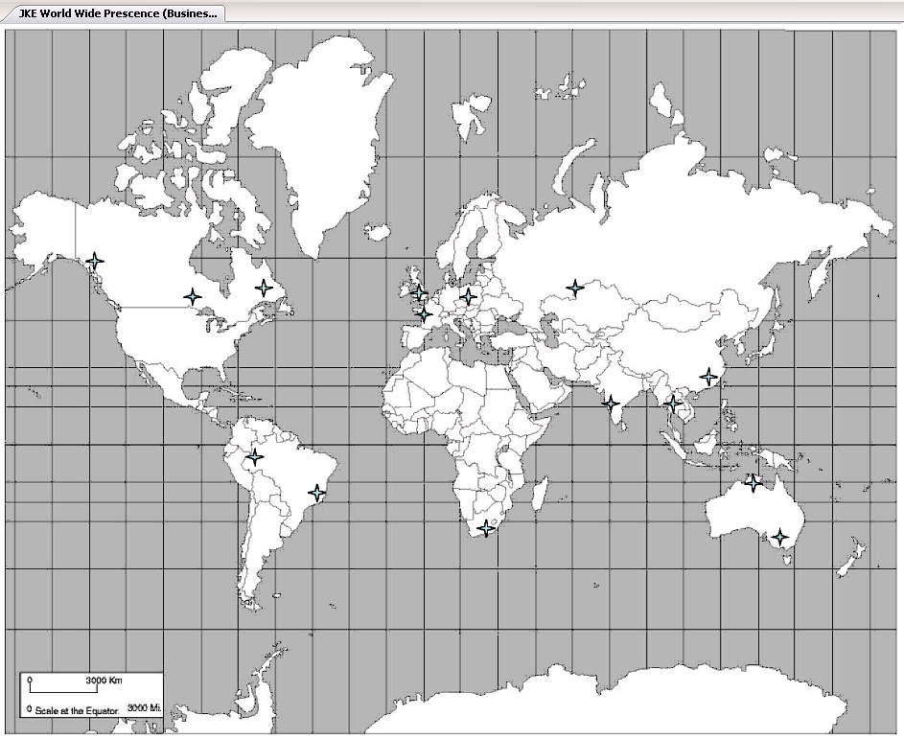
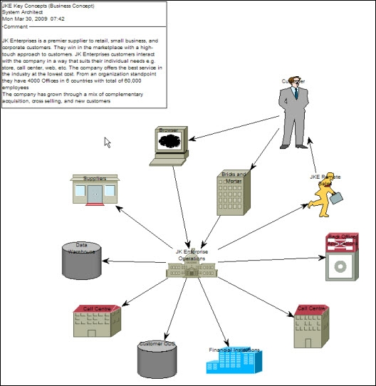
Capturing Key Business Concepts
Some loose concepts important to support our understanding

Slide 32
Conceptual Business Architecture
Eventually we want to understand
  Business Capabilities
  Processes
  People
At the Conceptual level we are only interested in high level
  Business Capabilities
  Processes

Slide 33
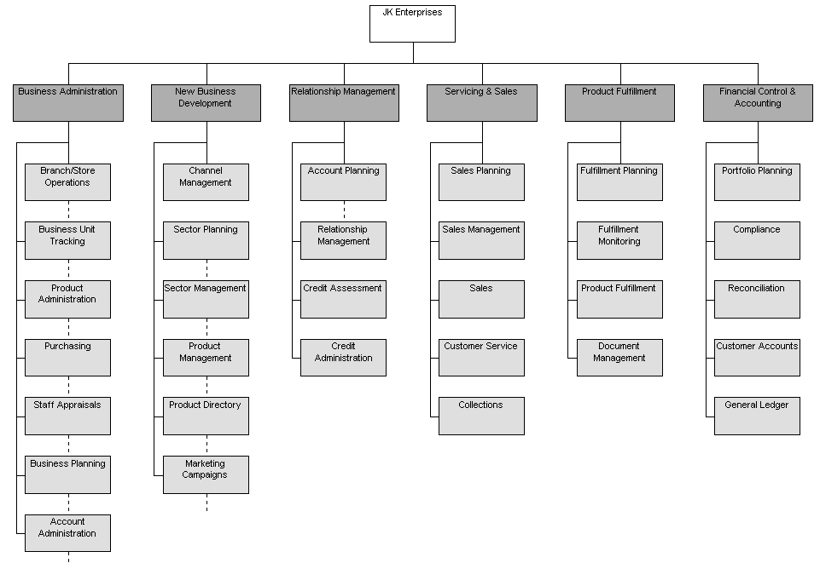
Business Capability
What does the business do?

Slide 34
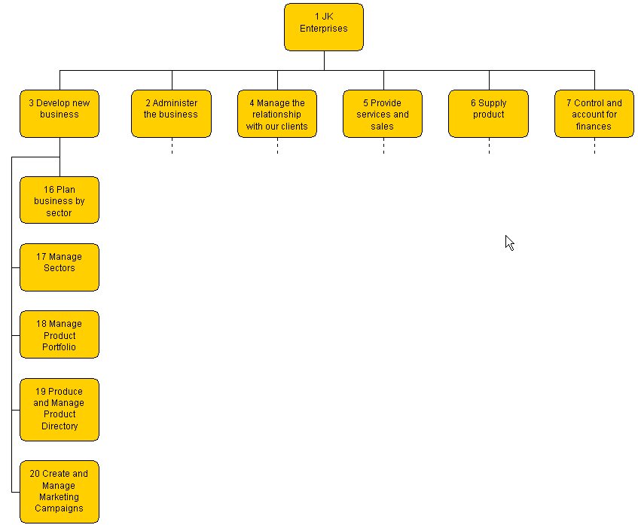
Business Activities
How does the business do these things?

Slide 35
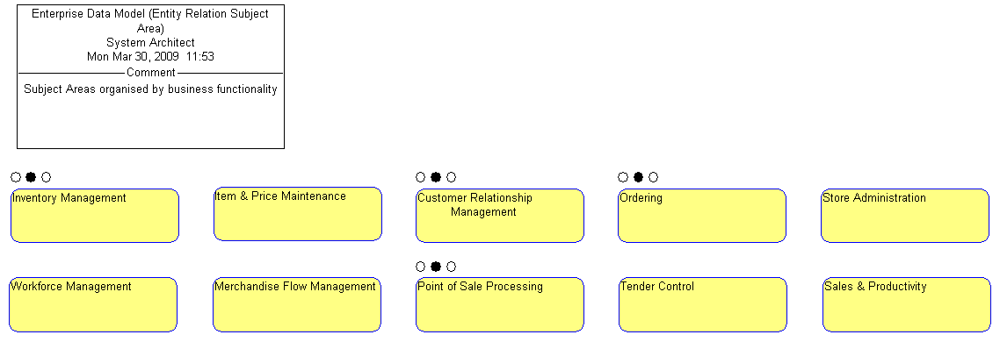
Conceptual Information Architecture
What are the key pieces of information the business needs?

Slide 36
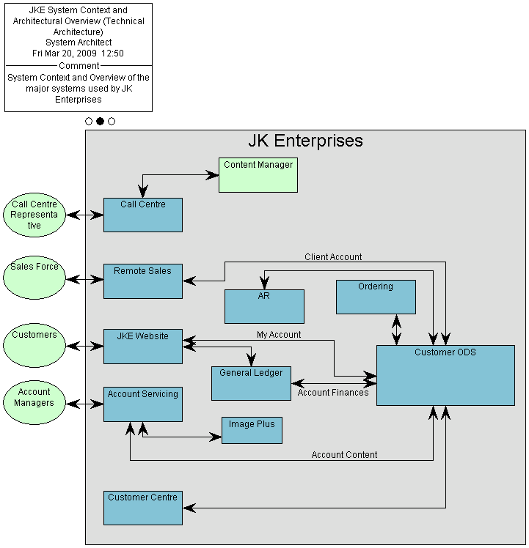
Conceptual Application Architecture
What are the key functions our applications must provide?

Slide 37
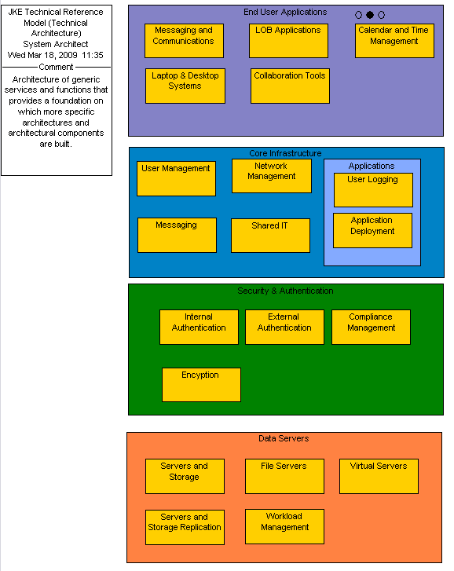
Conceptual Technology Architecture
What are the key technologies our applications and business need?

Slide 38
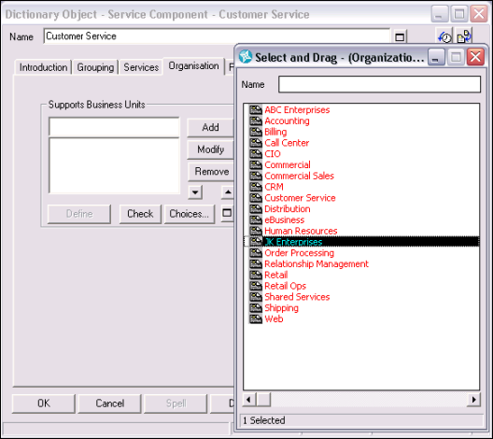
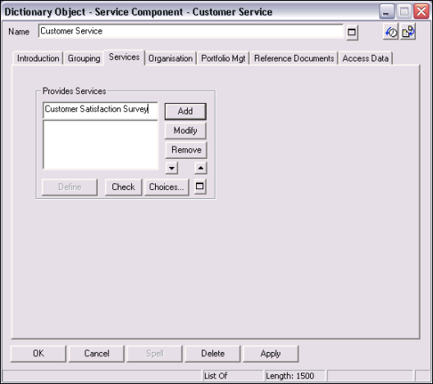
Detailing the Service Component
Specifying business unit that uses the Service Component
Specifying Services that the Service Component provides

Slide 39
Overview of TOGAF Phases
A. Define Architectural Vision
B. Business Architecture
C. Information Systems Architecture
D. Technology Architecture
E. Assess Opportunity and Solution Alternatives
Plus: Plan, Govern and Execute Solutions
Start here
Finish here

Slide 40
Information Architecture
In Phase C of the TOGAF Architecture Development Method (ADM) you model the Information System Architectures of the organization.
This includes the Data Architecture and the Applications Architecture.

Slide 41
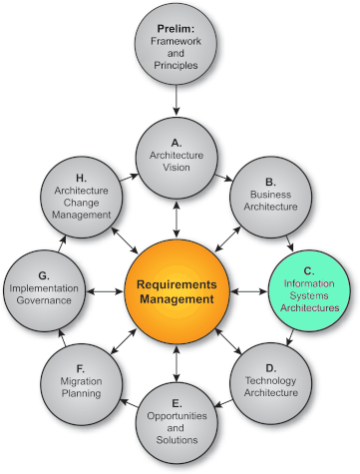
Objectives
Understand how to develop a high level Information architecture
  Define Subject Areas
  Drill down to next specification level
Value Statement
  Define the data reference architecture
  Communicate the information within the organization

Slide 42
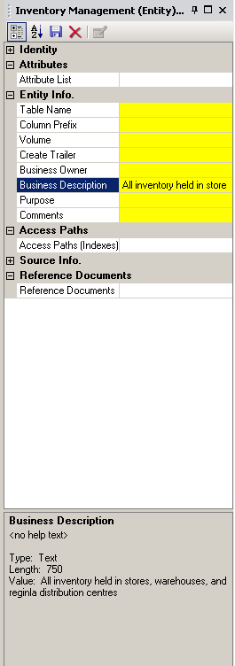
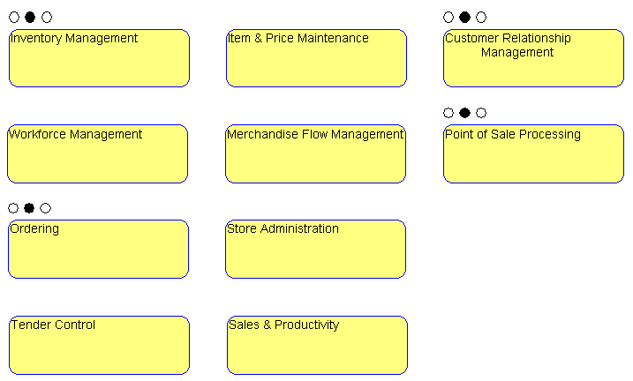
Enterprise Data Model
Entity Relationship Diagram
  Define the key information subject areas based upon output from the business architecture phase
  Provide business descriptions for each entity
Forms an information reference architecture

Slide 43
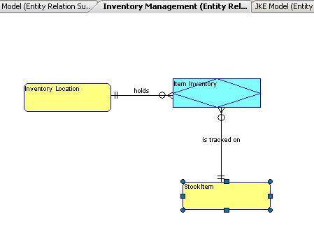
Refined Data Model
Drill Down from each subject area into first level refinement
  Create a child diagram for each EA data entity to represent the next level of abstraction
  Provides the capability to navigate the levels of abstraction

Slide 44
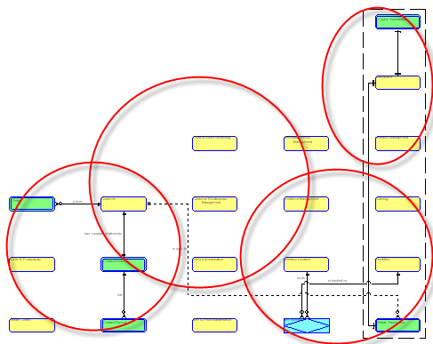
Consolidate Reference Model
Consolidate refined model
  Consolidate models belonging to the same viewpoint
  Provides comparative reference architecture views for Baseline and Target models
Automatically updated when models are changed

Slide 45
Objectives
Understand and learn how to describe the major types of applications systems required to support the enterprise
  How to use the Technical Architecture diagram to capture the required system capabilities
  Describe high level information flows
  How to elaborate and expand the Technical Architecture model
Value Statement
  Define and detail the major application systems as capabilities independent of the supporting technologies
  Used to perform gap, migration, and integration analyses

Slide 46
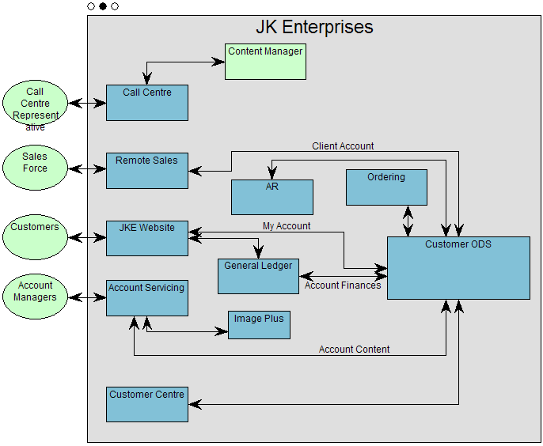
Refine Application Architecture
Technical Architecture Diagram shows
  System context
  Participants engaged in interacting with the business systems
  Functional capabilities of the applications as Architecture Building Blocks
  Major information flows
  Detailed by decomposition

Slide 47
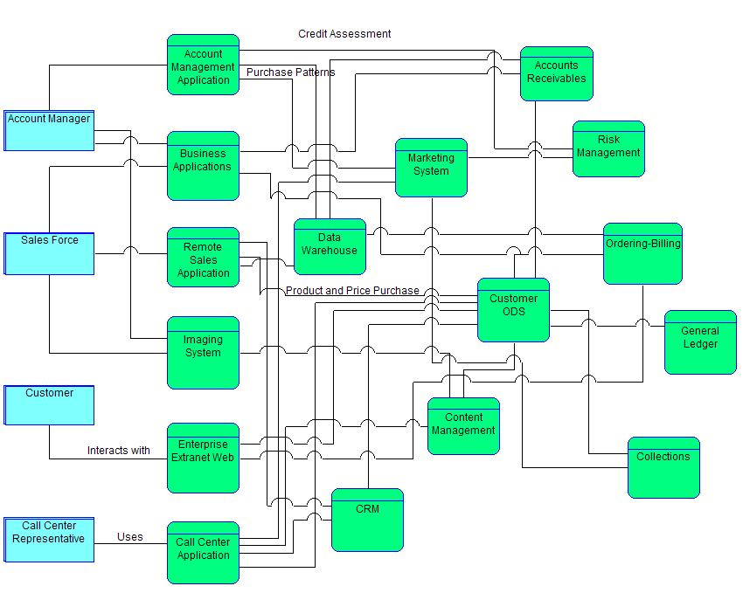
Refine Application Architecture
Technical Architecture Diagram decomposes to a System Architecture model, elaborates Application Systems
  Participants defined that are engaged in interacting with the business systems
  Architecture Building Blocks decompose into Application Components
  Information Flows elaborated as necessary

Slide 48
Overview of TOGAF Phases
A. Define Architectural Vision
B. Business Architecture
C. Information Systems Architecture
D. Technology Architecture
E. Assess Opportunity and Solution Alternatives
Plus: Plan, Govern and Execute Solutions
Start here
Finish here

Slide 49
Technology Architecture
The Technology Architecture phase seeks to map application components defined in the Application Architecture phase into a set of technology components, which represent software and hardware components, available from the market or configured within the organization into technology platforms.
As Technology Architecture defines the physical realization of an architectural solution, it has strong links to implementation and migration planning.
Technology Architecture will define baseline (i.e., current) and target views of the technology portfolio, detailing the roadmap towards the Target Architecture, and to identify key work packages in the roadmap. Technology Architecture completes the set of architectural information and therefore supports cost assessment for particular migration scenarios

Slide 50
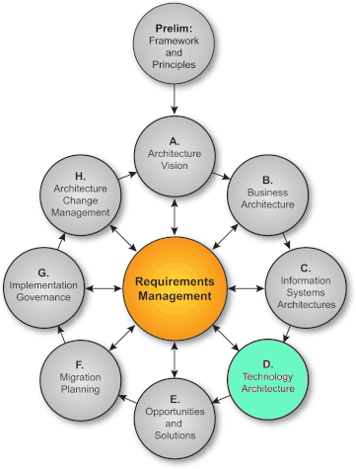
Objectives
Relevance and use of the Technical Reference Model
  Understand and learn how to refine technical architecture
Value Statement
  Provides a single taxonomy that defines terminology and provides a coherent description of the components and conceptual structure of the technical architecture
  Forms the basis and scope of all logical and physical implementations

Slide 51
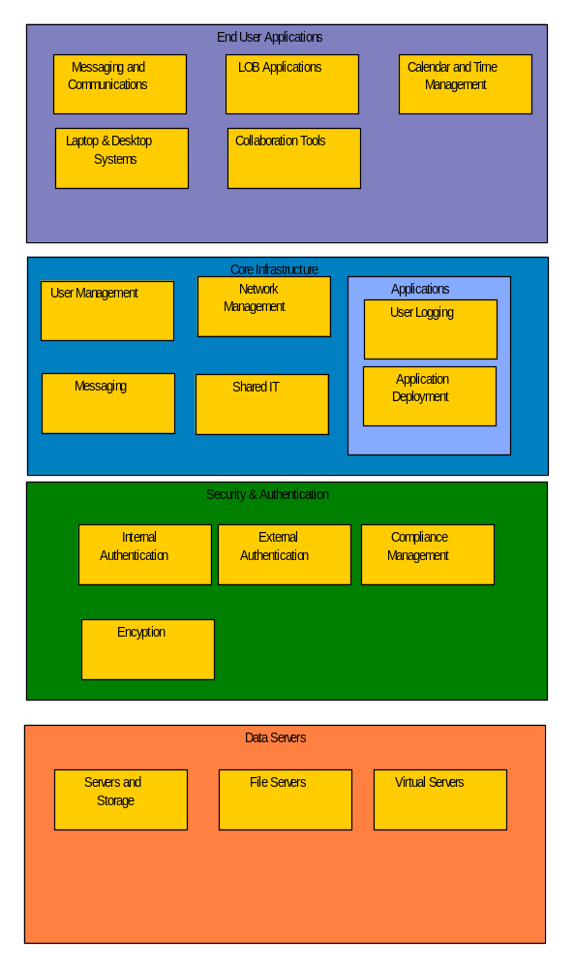
Refine Technical Architecture
Technical Reference Model
  Modeled as a Technical Architecture diagram
  Is an architecture of generic services and functions that provides a foundation on which more specific architectures and architectural components are built and detailed in the Business Architecture diagram

Slide 52
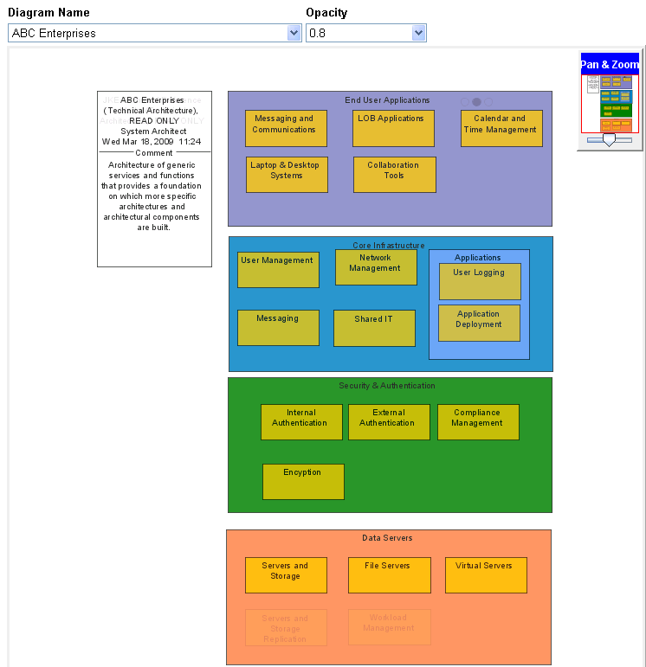
Compare Architectures
  Differences between technical architectures of the two enterprises shown by comparing and overlaying.
  Differences highlighted between the architectures must be addressed.
  Use in migration plans and gap analyses

Slide 53
Overview of TOGAF Phases
A. Define Architectural Vision
B. Business Architecture
C. Information Systems Architecture
D. Technology Architecture
E. Assess Opportunity and Solution Alternatives
Start here
Finish here

Slide 54
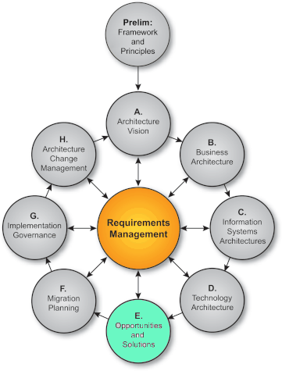
Objectives
Enterprise Architecture used for knowledge capture; learn how to apply enterprise architecture to support
  Analysis and decision making
  Gap analysis and migration planning
  Risk evaluation and mitigation
Value Statement
  Understand impact of changes
  Consolidate
    Application portfolios
    Services
    Technologies
    Information
  Plan scope of integrations
  Plan changes and prioritize actions
  Understand Business Products, Services, and Partners
  Ensure IT and Business decisions aligned with strategic business intent and delivered architecture

Slide 55
The end --- thank you and questions welcome or email me at wintonjkt@gmail.com

